Slide 1

Welcome!!!
Sign in
Sign up

Slide 2



email
johndoe123@email.com
password
***********
Proceed
Or continue with

Slide 3
Please fill in the needed details
Name
first name
last name
John
Doe
Email
email
johndoe123@email.com
Password
password
***********
Phone number
phone no.
0911-234-567
Sex
Male
Female
Register

Slide 4

You are now registered!
Thank you!
Ok
Notes:
You are registered!

Slide 5
Please fill in the needed details
Name
first name
last name
Welcome!!!
Email
email
email
Sign in
Password
password
password
Sign up
Proceed
Phone number
Or continue with
phone no.
Sex
Male
Female
Register

Slide 6
Greetings,
John Doe!
Book now
Check Ticket
History
Log out

Slide 7

Book now
Your current location
auto-generated station
Somewhere Station
Select your destination
select
Ticket type
VIP
REGULAR
Total Amount:
Php. 00.00
Next

Slide 8
Select
Schedule
Train No.
Arrival Time
Select
101
6:00 am
104
7:15 am
110
7: 45 am
115
8:18 am
Next

Slide 9
Upcoming Train Schedule
Train No.
Arrival Time
101
6:00 am
104
7:15 am
110
7: 45 am
115
8:18 am
Next

Slide 10

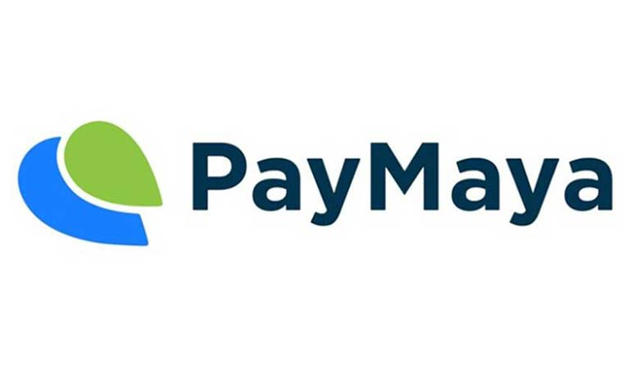
Method of Payment

Slide 11
Transaction
Details
Destination:
Generated station – Desired station
Ticket Type:
VIP – Php. 20.00
Method of Payment: GCash
Train: 101 | 6:00 am OR
110 | 7:45 am
Done

Slide 12
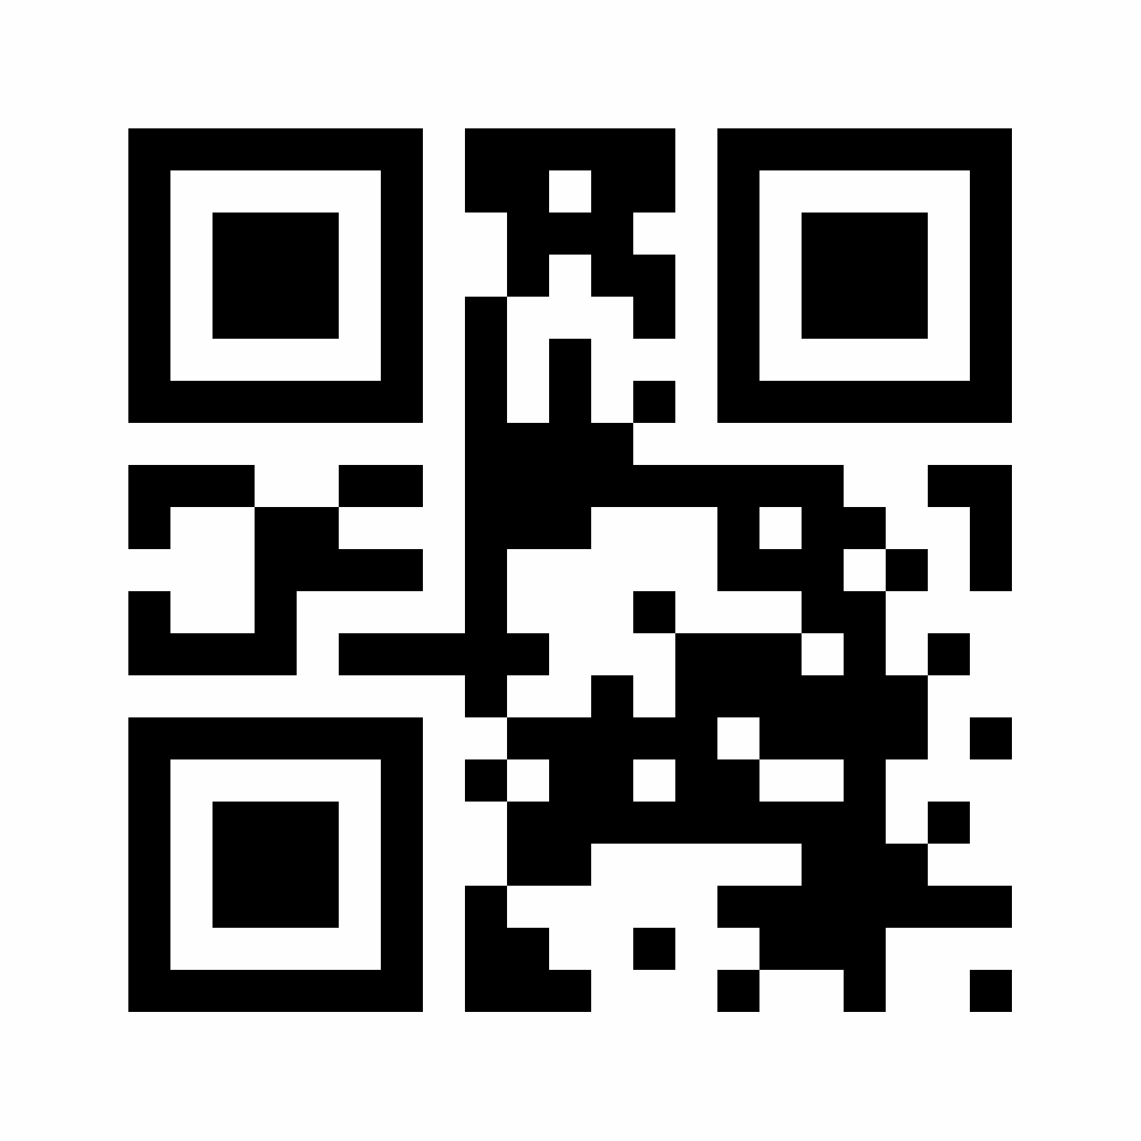
Ticket
Scan to check
ticket details
OK

Slide 13
History
Date
Destination
09/01/19
Station 1 – Station 5
09/05/19
Station 5 – Station 3
09/10/19
Station 5 – Station 10
OK

